Slide 1

Object Oriented Programming
.net

Slide 2
Object-Oriented Programming (OOP) is based on the concept of "objects", which contain data in the form of fields (attributes/properties), and code in the form of procedures (methods). In OOP, computer programs are designed by making them out of objects (classes) that interact with one another.
https://en.wikipedia.org/wiki/Object-oriented_programming

Slide 3
Four Pillars of OOP https://www.linkedin.com/pulse/4-pillars-object-oriented-programming-pushkar-kumar#:~:text=
The four pillars of OOP
Abstraction : The process of showing only essential/necessary features of an entity/object to the outside world and hide the other irrelevant information.
Encapsulation : Wrapping data and member functions (Methods) together into a single unit (class). Encapsulation automatically achieves the concept of data hiding. This provides security to data by making variables private and allowing public methods to access the private variables.
Inheritance : Creating a new class from an existing class template. A class (subclass) acquires the properties and behavior of a ‘base’ (‘super’) class.
Polymorphism: "many forms". A subclass can inherit functionalities or behavior of its parent/base class and define its own unique behavior.

Slide 4



Abstraction https://stackify.com/oop-concepts-c-sharp/#:~:text=
Abstraction is the process by which a developer separates the relevant data from the irrelevant details in order to simplify use.
Abstraction in daily life
Apartment Building. We determine what the building is by it’s exterior or name but don’t know the specifics as to how the people live.
Factory.
Snail Mail.

Slide 5
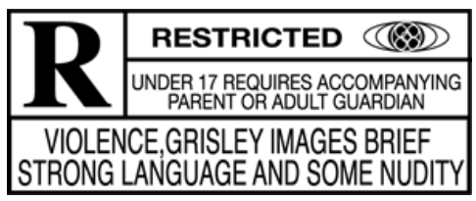
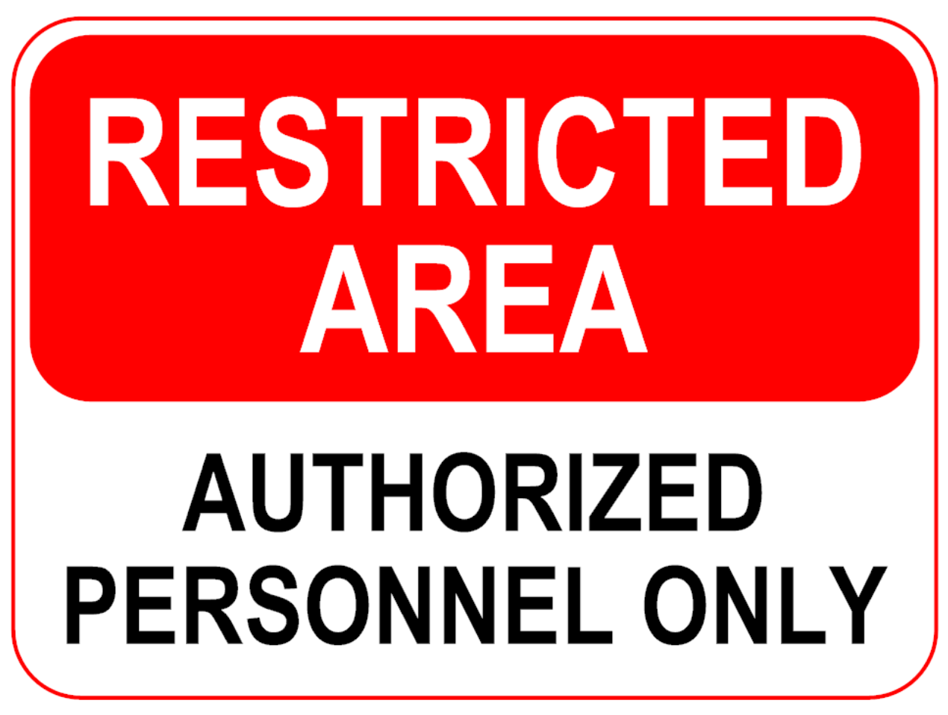
Encapsulation https://en.wikipedia.org/wiki/Encapsulation_(computer_programming)
Encapsulation the restricting of direct access to abstracted data.
Encapsulation prevents unauthorized parties' direct access to the members of a class. Publicly accessible methods are generally provided in the class (so-called "getters" and "setters") to access the values.

Slide 6



Inheritance https://docs.microsoft.com/en-us/dotnet/csharp/tutorials/inheritance#:~:text= https://docs.microsoft.com/en-us/dotnet/csharp/fundamentals/object-oriented/inheritance
Inheritance allows you to define a child (derived) class that reuses (inherits) the characteristics of a parent class.
The class that Inherits the members of the base class is called the derived class.
structs, delegates, and enums do not support inheritance.

Slide 7
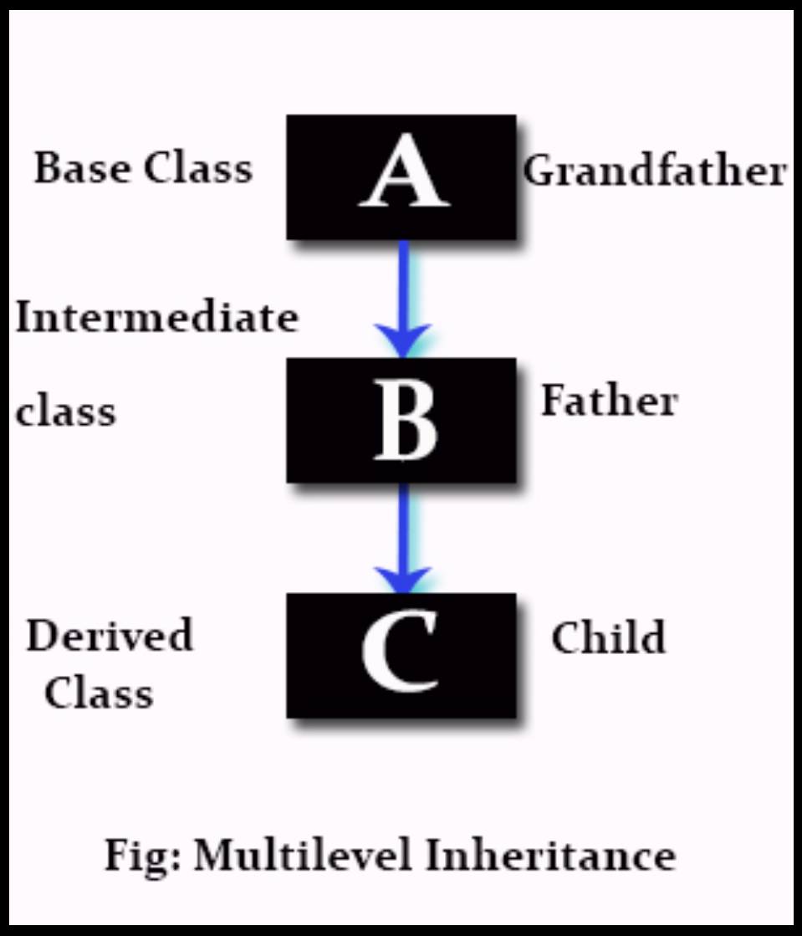
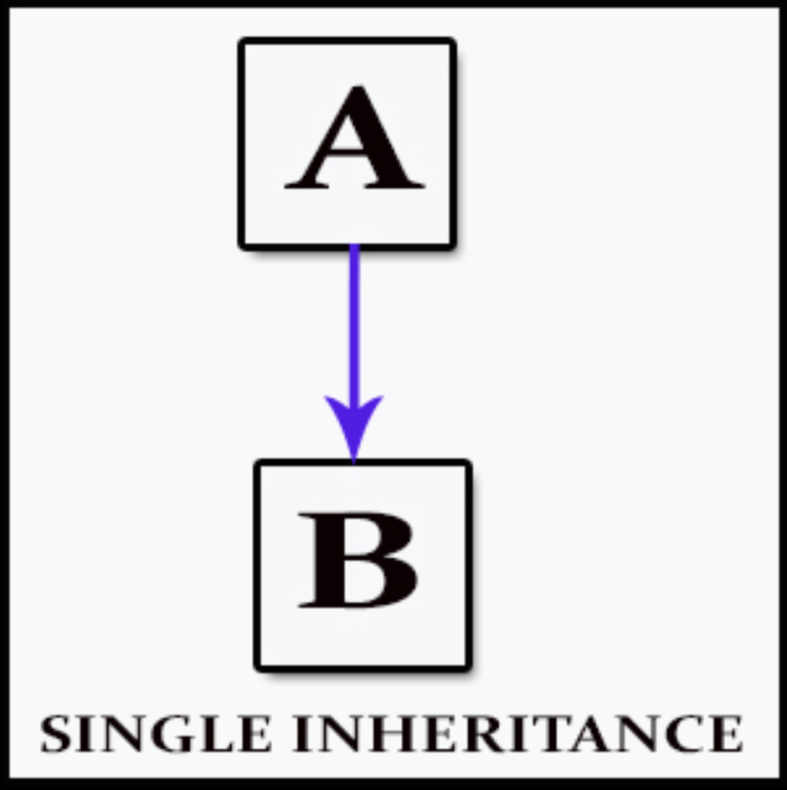
Inheritance - Types https://stackify.com/oop-concepts-c-sharp/#:~:text= https://en.wikipedia.org/wiki/Inheritance_(object-oriented_programming)
Single inheritance(C#) – A subclass inherits the features of one superclass.
Multilevel inheritance(C#) - A subclass is inherited from another subclass, and so on.
Parent Class
Derived Class

Slide 8
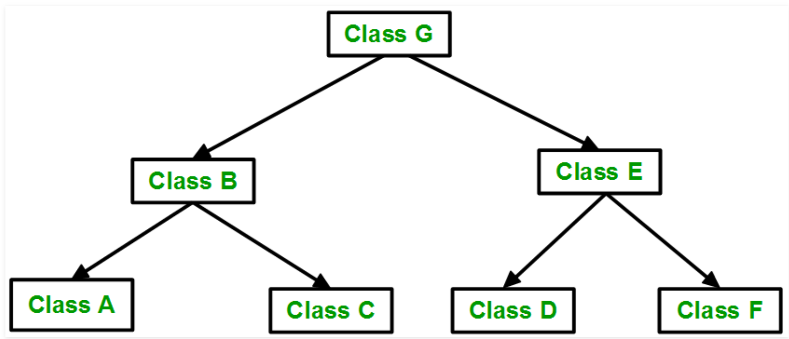
Inheritance - Types https://stackify.com/oop-concepts-c-sharp/#:~:text= https://en.wikipedia.org/wiki/Inheritance_(object-oriented_programming) https://www.geeksforgeeks.org/inheritance-in-c/
Hierarchical inheritance(C#) - where one class serves as a superclass (base class) for more than one sub class.

Slide 9
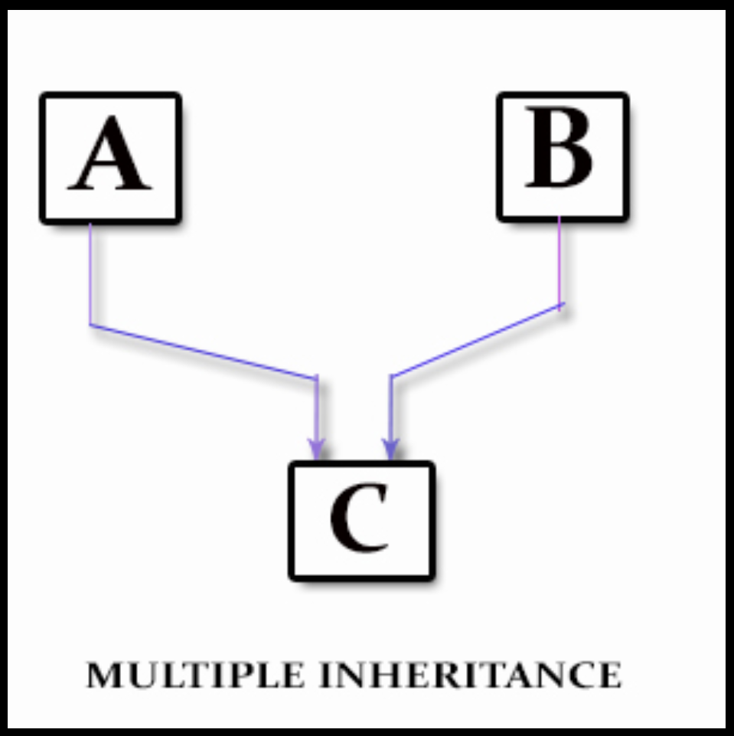
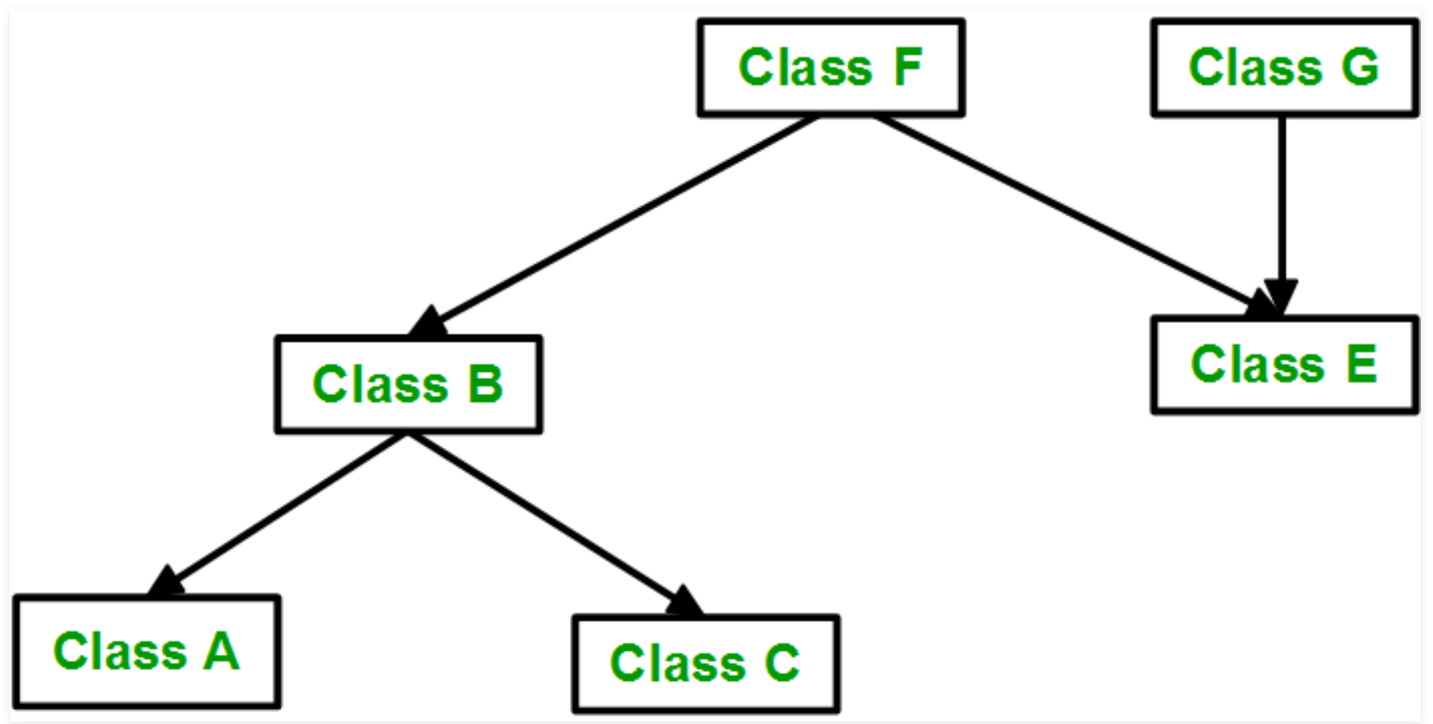
Inheritance - Types https://stackify.com/oop-concepts-c-sharp/#:~:text= https://en.wikipedia.org/wiki/Inheritance_(object-oriented_programming) https://www.geeksforgeeks.org/inheritance-in-c/
Multiple inheritance(NOT IN C#) - one class can have more than one superclass and inherit features from all parent classes.
Hybrid inheritance(NOT IN C#) - a mix of two or more types of inheritance.
NOT IN C#

Slide 10
Inheritance and Access Modifiers https://docs.microsoft.com/en-us/dotnet/csharp/tutorials/inheritance#:~:text=
Access Modifiers affect inheritance
Private - members are not inherited.
Public Get/Set methods can be created in the parent class to give derived classes access to the private data.
Constructors are also not inherited.
Protected - visible only to derived classes.
Internal - visible only in the same assembly (project) as the class.
Public - visible in derived classes and are part of the derived classes public interface.

Slide 11
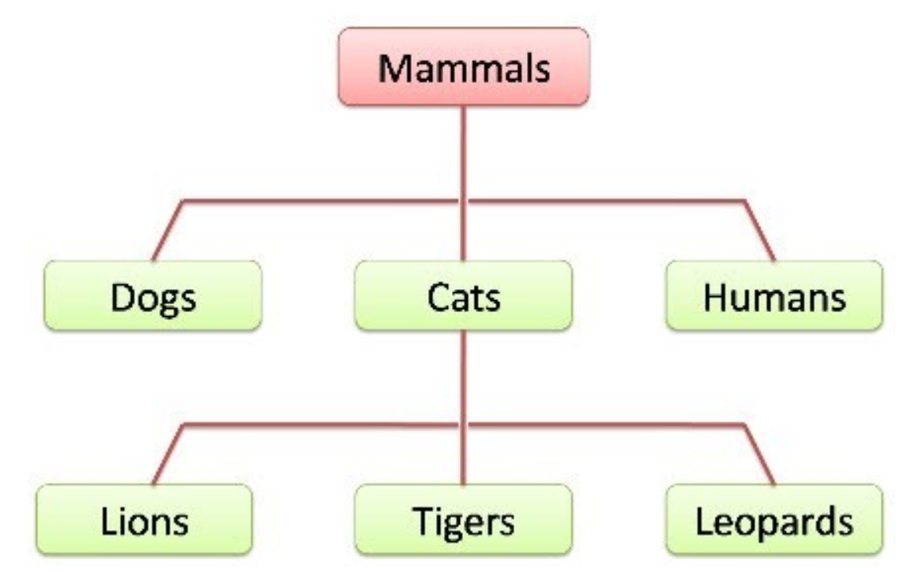
Inheritance – an ‘is a’ relationship https://docs.microsoft.com/en-us/dotnet/csharp/tutorials/inheritance#:~:text= https://docs.microsoft.com/en-us/dotnet/csharp/fundamentals/object-oriented/inheritance
Inheritance is used to express an "is a" relationship between a base class and one or more derived classes, where the derived class ‘is a’ specialized version of the base class.
An ‘is-a’ relationship based on inheritance is best applied to add additional members to the base class or that require additional functionality not present in the base class.

Slide 12
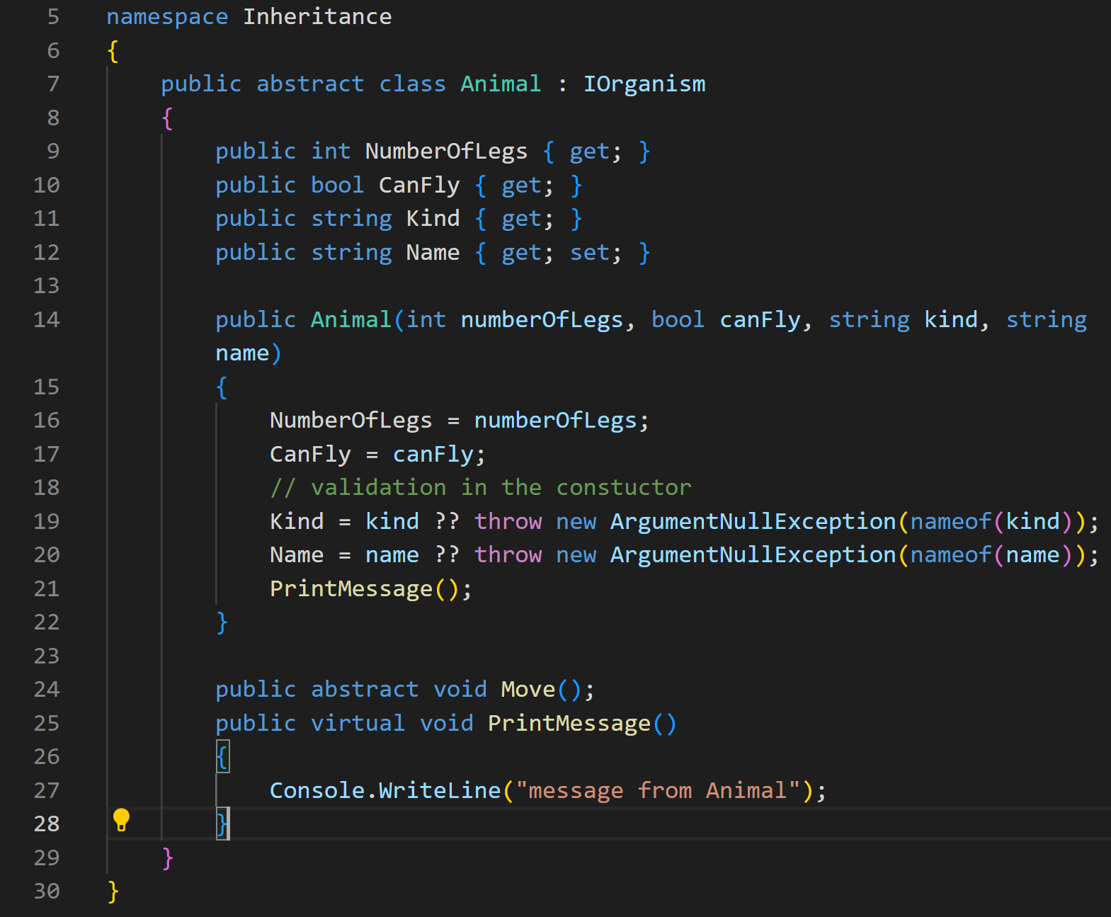
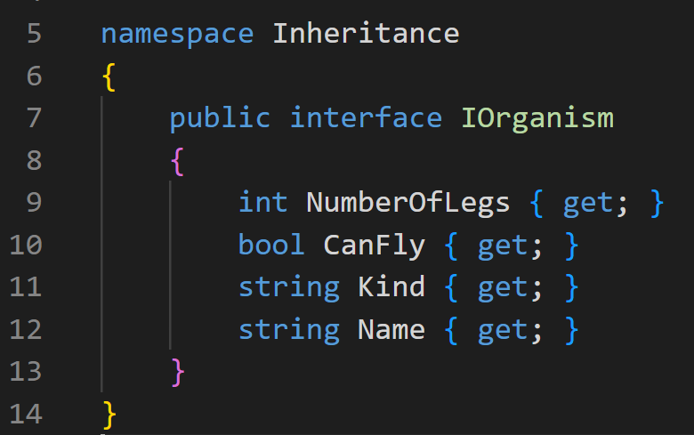
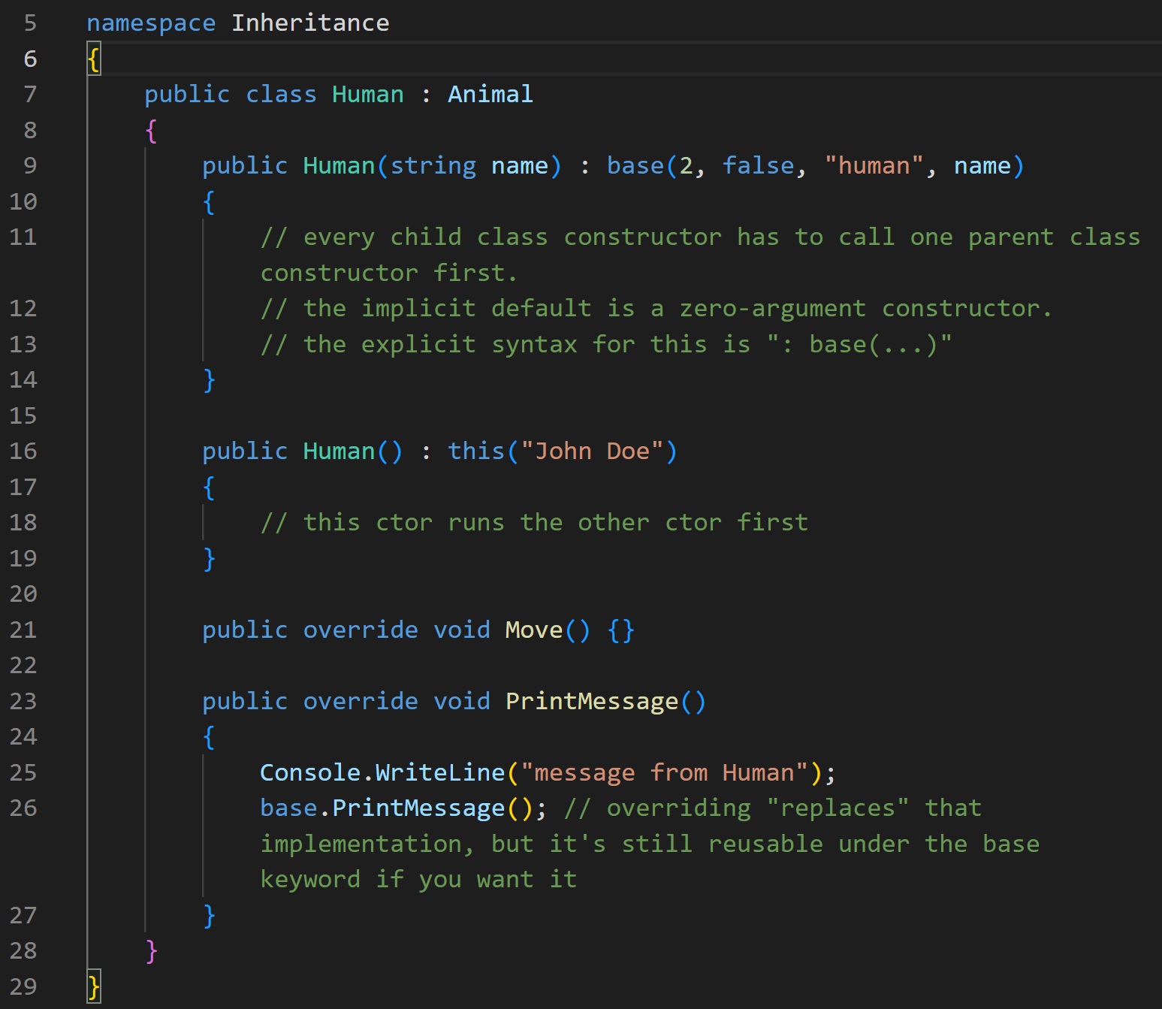
Polymorphism https://docs.microsoft.com/en-us/dotnet/csharp/tutorials/inheritance#designing-the-base-class-and-derived-classes https://docs.microsoft.com/en-us/dotnet/csharp/fundamentals/object-oriented/polymorphism
Polymorphism is when a derived class implements the base class methods, but in a different way.
Abstract class members are incomplete so they must be defined in the derived class.
Only virtual base class members may be overridden.
Only derived class members using the override keyword may implement an alternative definition of any virtual base class member.

Slide 13
Activity
Complete the implementation of the Publication => Book program.

